Slide 1





TIMETABLE PLANNER WEBSITE
AC4150E
-
152296
User Need Finding
From:
Group 3

Slide 2




Table of Contents!
Analysis
Team Introduction
Summary
Methodology
Also Included:
Consent Form
Interview Result

Slide 3

01
Team Introduction

Slide 4
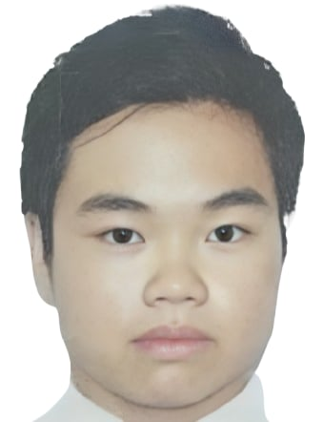



Nguyen Gia Bao
Nguyen Do Hoang Minh
Nguyen Huu Phong
20210099
ET-E16 – K66
20210591
ET-E16 – K66
20210668
ET-E16 – K66

Slide 5


Domain and Keywords
Education Technology
Student Scheduling
Time Management
Timetable Visualization
Course Registration
Online Education Tools
Academic Planning
Customizable Timetables

Slide 6
02
Methodology

Slide 7

Target Participants
Current HUST students.
Students from other schools/universities.
User Groups
Normal Users (3): Basic tools/methods for scheduling.
Expert Users (1): Advanced knowledge of the systems.
Extreme Users (1): Unique/advanced scheduling behaviors.
Interview Method
HUST students: Offline interviews, face-to-face at school (5-10, max 20 mins).
Other students: Online interviews (Zoom, Messenger, etc.) (5-10, max 20 mins).

Slide 8

Questions
“How do you usually arrange your timetable? (Do you use any tools, like Excel, paper and pen, or websites?)”
Tools/Methods
“Are there any concerns you have when using these tools?”
User Experience
“How do you feel when arranging your schedule for a new semester? Do you feel stressed when selecting courses or organizing them?”
Feelings and Emotions
“Have you ever needed to share your timetable with friends or professors? If so, do you think sharing your schedule would be a useful feature?”
Difficulties and Solutions
“What do you think of the interface of the current system? Do you wish it would change in any way?”
Customizability and Features

Slide 9




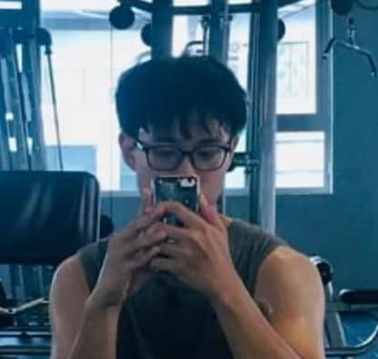
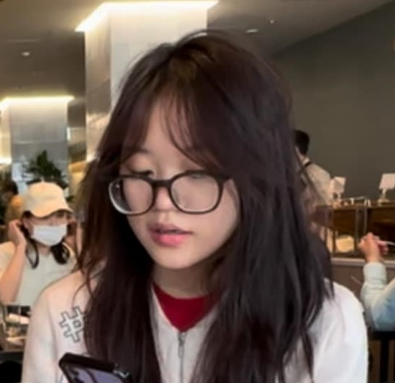

Participants
Minh*
Expert User
Tai, Rose, Son, NMinh
Normal Users
Linh*
Extreme User
*: pseudonym

Slide 10
03
Interview Result

Slide 11
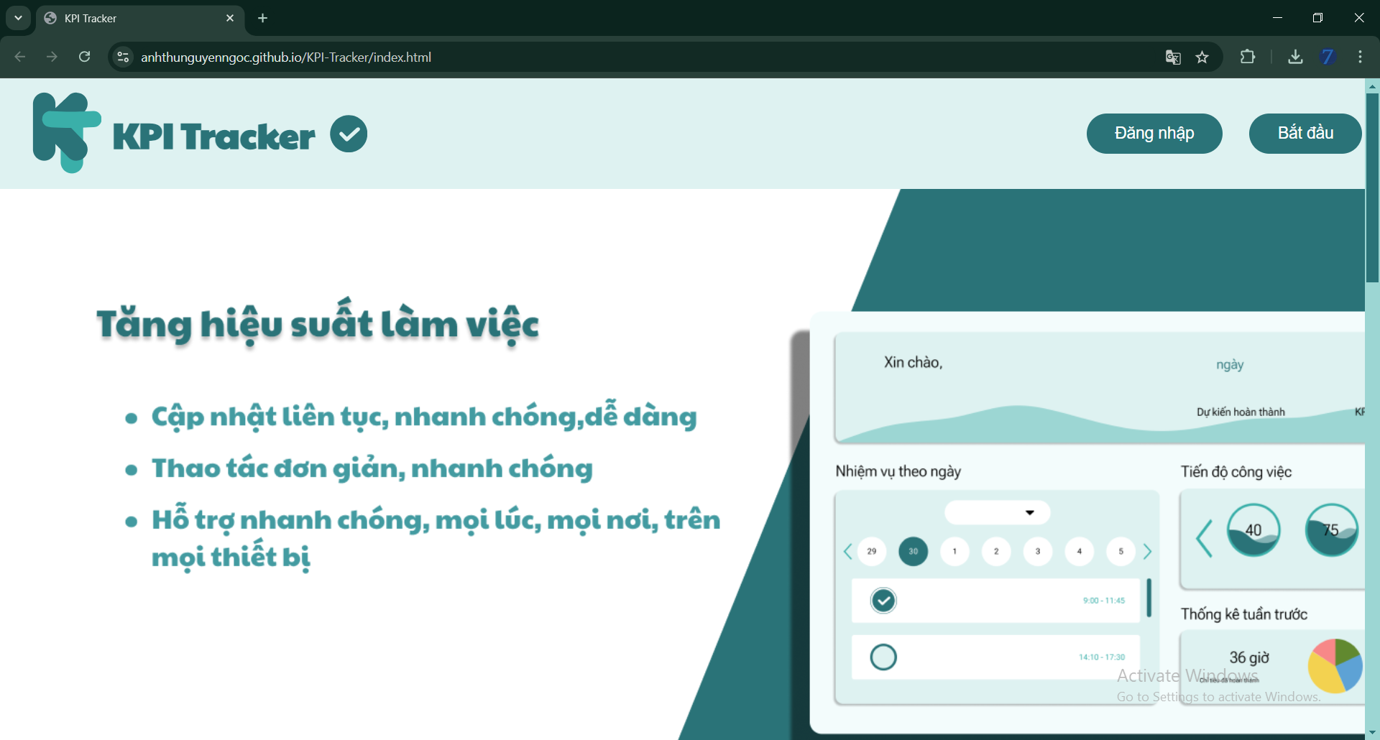
"Registering for classes is always a tough competition."
"Organizing a timetable online is really essential because it's more convenient than traditional methods."
Minh* (20)
"Different sessions of the same class are shown as if they are different classes."
4th year student from SOICT, HUST
Expert User (has experience in planner web development)
Offline Interview
"Both front-end and back-end optimizations are important."

Slide 12
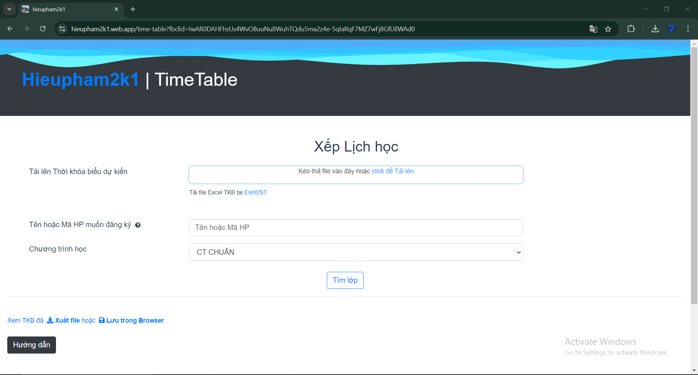
"I find online tools for scheduling timetables very useful... They save me a lot of time compared to traditional methods."
"I don’t usually feel stressed when setting up my timetable for a new semester."
Tai (20)
"Yes, I’ve already introduced the website to some friends for course registration."
3rd year student from SEEE, HUST
Normal User (has experience in using planner website)
Offline Interview
"I think everyone’s schedule is private and personal."

Slide 13
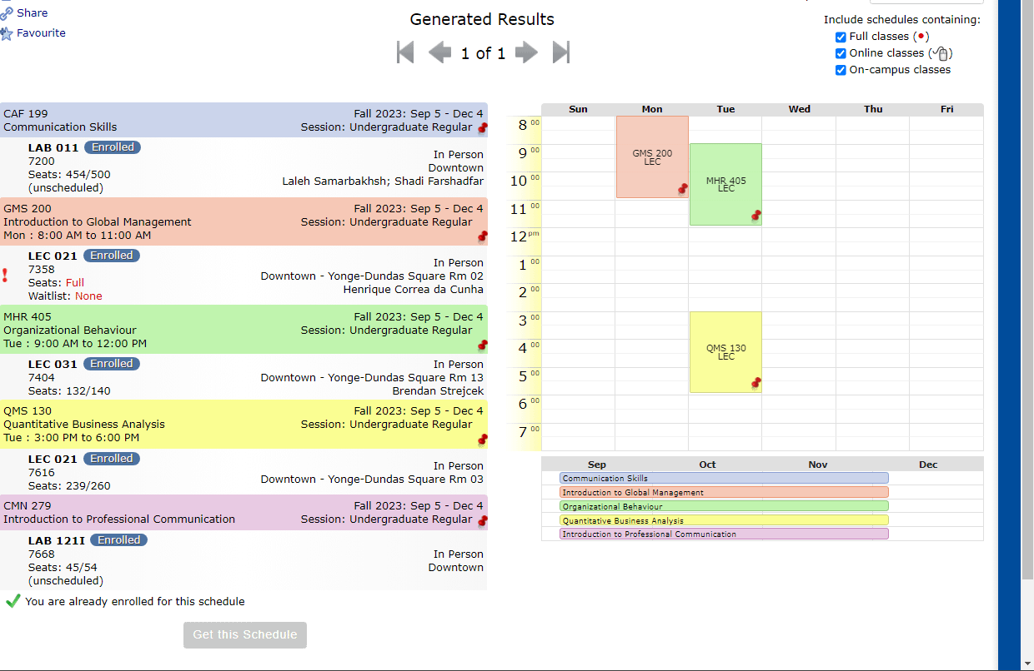

"I would definitely tell anyone that it’s a solid tool if they were to ask."
"Every enrollment period feels like a battle... there’s a lot of pressure to make sure you get into the classes you need."
Rose (21)
"The scheduling tool automatically prevents you from enrolling in classes that overlap."
Student from Toronto Metropolitan University in Ontario, Canada
Normal User (has experience in using Notes on iPhone + Visual Schedule Builder)
Online Interview
"It’s useful when I need to send my schedule to my job... having a built-in feature to share would be really helpful."

Slide 14
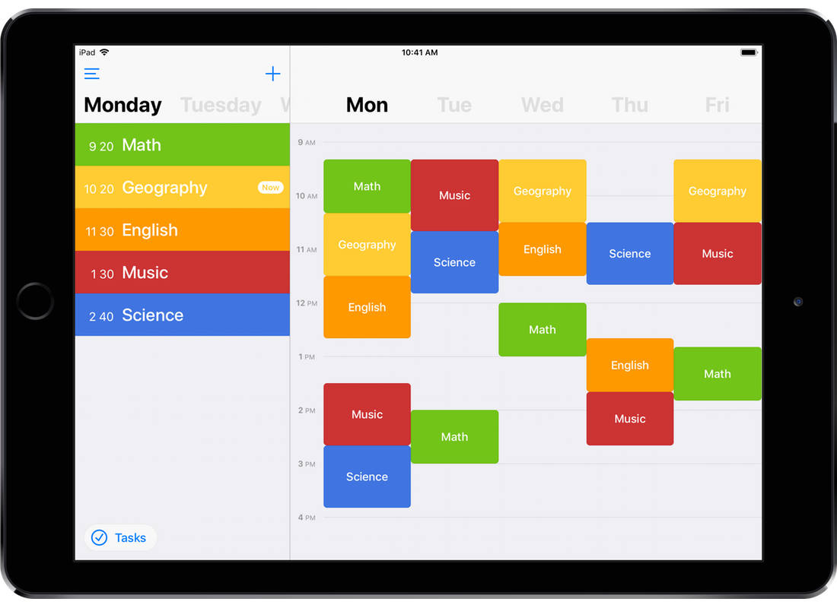

"Online tools are really useful... they simplify the process of organizing everything in one place."
"Organizing my schedule isn’t really a stressful process."
Son (21)
"I really appreciate the app’s speed and the overall smooth experience."
4th year student from HNUE
Normal User (has experience in using planner app)
Online Interview
"I’m satisfied with the current interface... but I’d probably want more customization options."

Slide 15

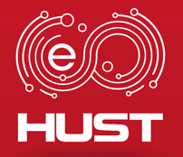

"I find it pretty easy... the website has made the process straightforward and quick."
"The university’s official system... has quite a few issues with the layout."
NMinh (21)
"I don’t usually have any issues with scheduling, thanks to the website I use."
4th year student from SEEE, HUST
Normal User (has experience in using planner website + apps)
Online Interview
"I don’t feel the need to customize my timetable."

Slide 16
"I haven’t come across any specific applications yet, so I don’t have any personal impressions about them."
"The thought of automating that process sounds incredibly appealing."
"I worry that it might be more complicated than I expect and that I might encounter a learning curve."
Linh* (18)
1st year student from RMIT, Hanoi
Extreme User (manually plans timetable with helps from Notes on iPhone)
Offline Interview
"I’m drawn to visually appealing designs... a cute and attractive interface would motivate me."

Slide 17

04
Analysis

Slide 18
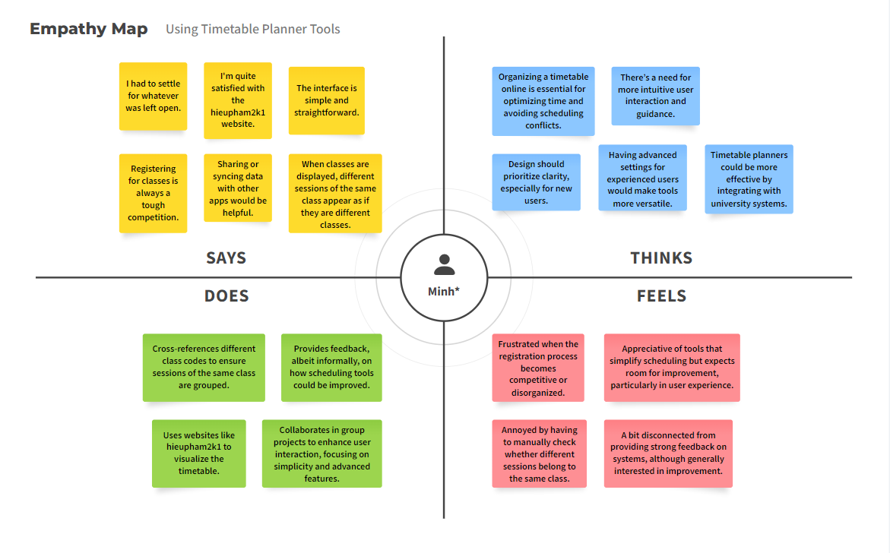
Minh*

Slide 19
Needs
Insights
Efficient Scheduling: Quick, clear course management.
Data Integration: Sync with university systems to avoid conflicts.
Simple Interface: Easy to use, with advanced options for experts.
Customization: Instructor filters, sync with external apps.
Automation is Key: Syncing saves time and reduces errors.
Visual Clarity: Unified views prevent confusion.
Balance: Users want simplicity with flexible, advanced features.

Slide 20
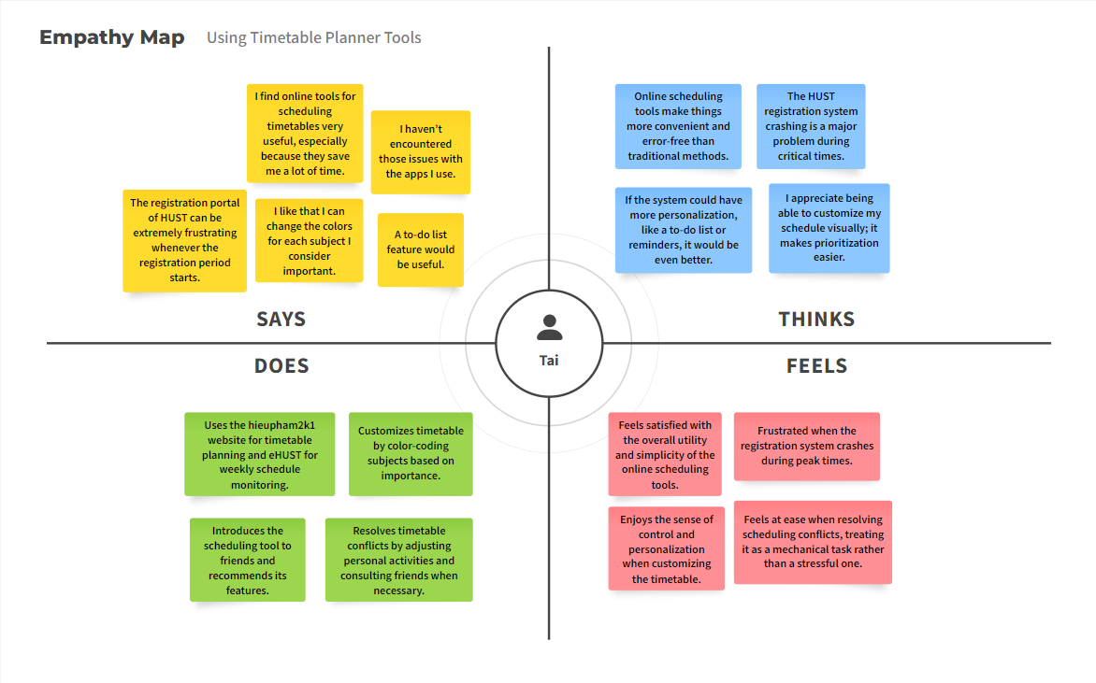
Tai

Slide 21
Needs
Insights
Stability: Reliable, crash-free system, especially during registration.
Customization: Personalize with colors and reminders.
Efficient Organization: Easy, clear scheduling without overlaps.
Simple Interface: Intuitive and easy to use, with helpful features.
Convenience: Online tools save time and effort.
Reliability: Stable performance is critical during registration.
Personalization: Custom options enhance control and satisfaction.
Low Stress: Users prefer simple, efficient tools, with extras as bonuses.

Slide 22
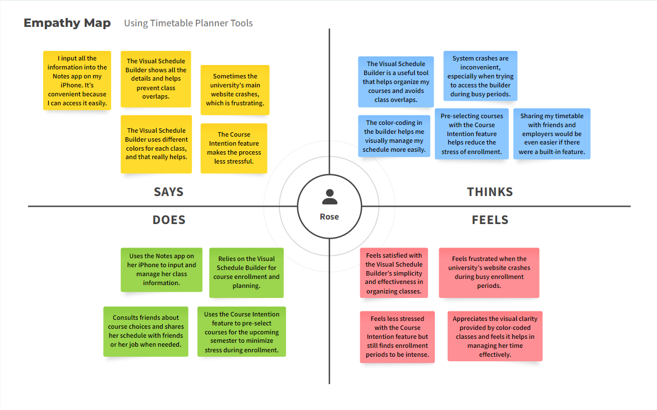
Rose

Slide 23
Needs
Insights
Reliability: Stable site during enrollment.
Customization: Simple tools with color-coding and clear layout.
Stress Relief: Pre-select courses to reduce anxiety.
Sharing: Easy schedule sharing for planning.
Simplicity: Straightforward tools prevent conflicts.
Efficiency: Crashes during peak times cause frustration.
Visual Clarity: Color-coding boosts usability.
Sharing: Customizable sharing options needed.

Slide 24
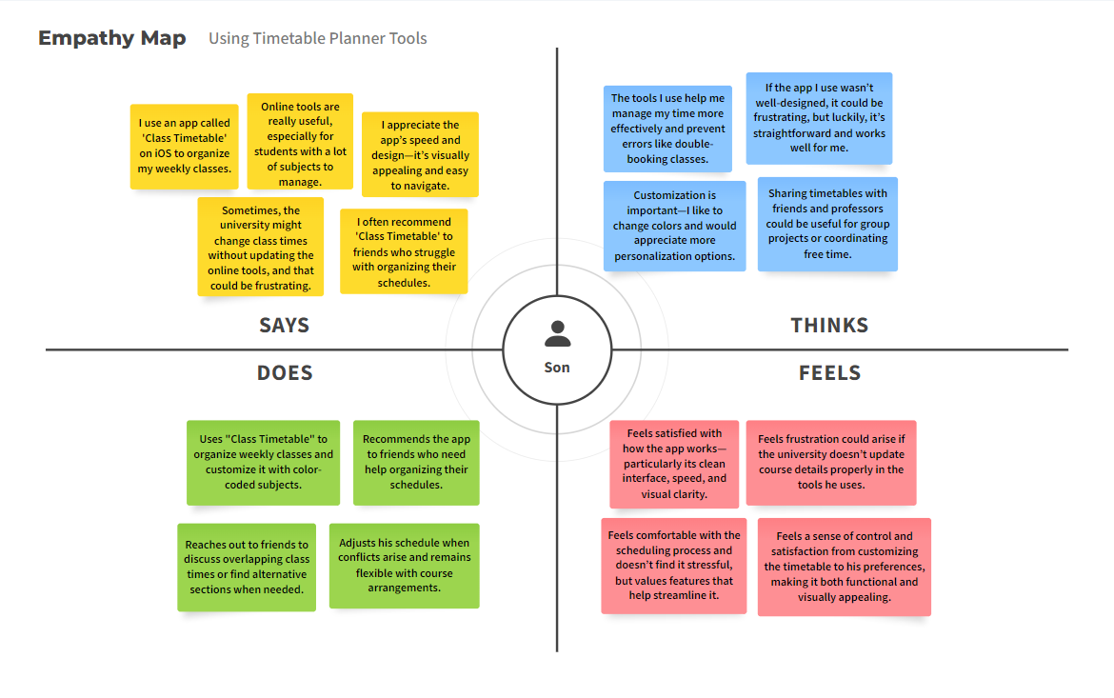
Son

Slide 25
Needs
Insights
Reliable Updates: Timely info on class changes.
Customization: Personalize timetables (colors, layouts).
Sharing Tools: Easy sharing with peers and professors.
Error Prevention: Avoid scheduling conflicts, flexible adjustments.
User-Friendly: Simple, fast tools ease organization.
Engagement Through Customization: Color-coding aids usability; more options would boost engagement.
Critical Consistency: Reliable university info is essential.
Future Sharing Needs: Easy sharing features benefit group coordination.

Slide 26
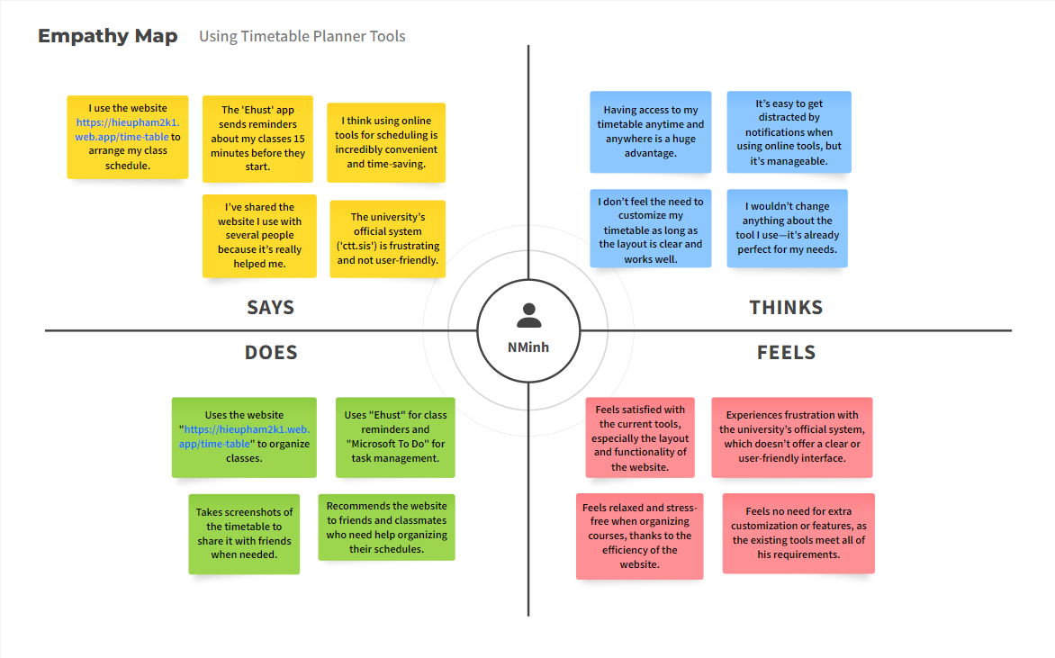
NMinh

Slide 27
Needs
Insights
Easy Access: Simple, clear, and mobile-friendly tools.
Timely Reminders: Notifications to track schedules.
Conflict Prevention: Tools to avoid overlaps and show complete schedules.
Sharing Options: Easy sharing features for collaboration.
Prefer Simplicity: Functionality over customization.
Convenient Access: Mobile access reduces stress.
Frustration with University Tools: Third-party apps are often better.
Collaboration Needs: Sharing features are beneficial for group work.

Slide 28
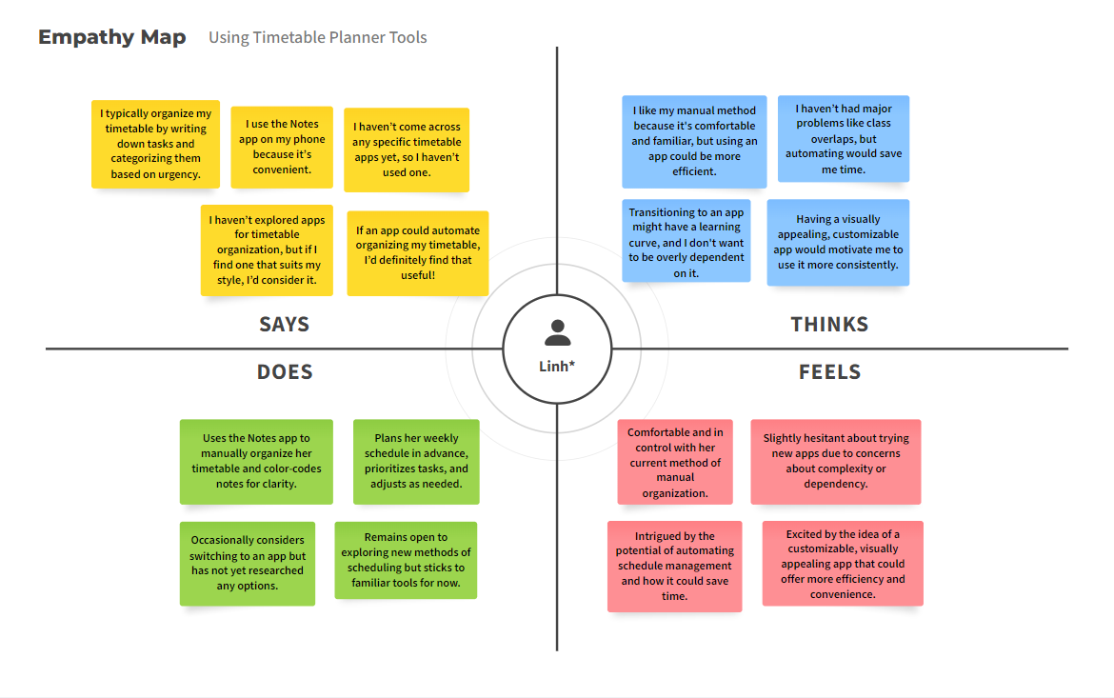
Linh*

Slide 29
Needs
Insights
Familiar Tool: Wants an intuitive app that feels familiar.
Automated Efficiency: Seeks automation while keeping control.
Customizable Options: Values personalization for engagement.
Control Assurance: Prefers to avoid dependency on technology.
Open to Digital: Will switch if it suits habits.
Customization Matters: Needs visual appeal to stay engaged.
Efficiency with Control: Wants to save time but maintain oversight.
Skeptical but Open: Interested in free apps with clear benefits.

Slide 30


Tensions and Contradictions
Simplicity vs. Customization
Technological Hesitance vs. Digital Acceptance
Reliability vs. Flexibility
Need for straightforward tools vs. desire for personalization;
extremes feel overwhelmed, normals feel restricted.
Demand for reliable systems during peak times vs. need
for flexible schedule management; crashes cause frustration.
Extreme users are skeptical; normals and experts embrace
technology.

Slide 31


Surprises
Simplicity vs. Customization
Normals prefer third-party tools,
highlighting gaps in university
offerings.
Importance of Visual Design
Visual appeal boosts usability and
engagement more than expected.

Slide 32
05
Summary

Slide 33

Summary
Common Needs
Development Insight
Users want simplicity, reliability, and collaboration.
Address diverse user preferences while tackling shared challenges in scheduling.
Key Tensions
Balancing simplicity with customization and ensuring reliability without sacrificing flexibility.
Please remember before going to the next step! ☺

Slide 34
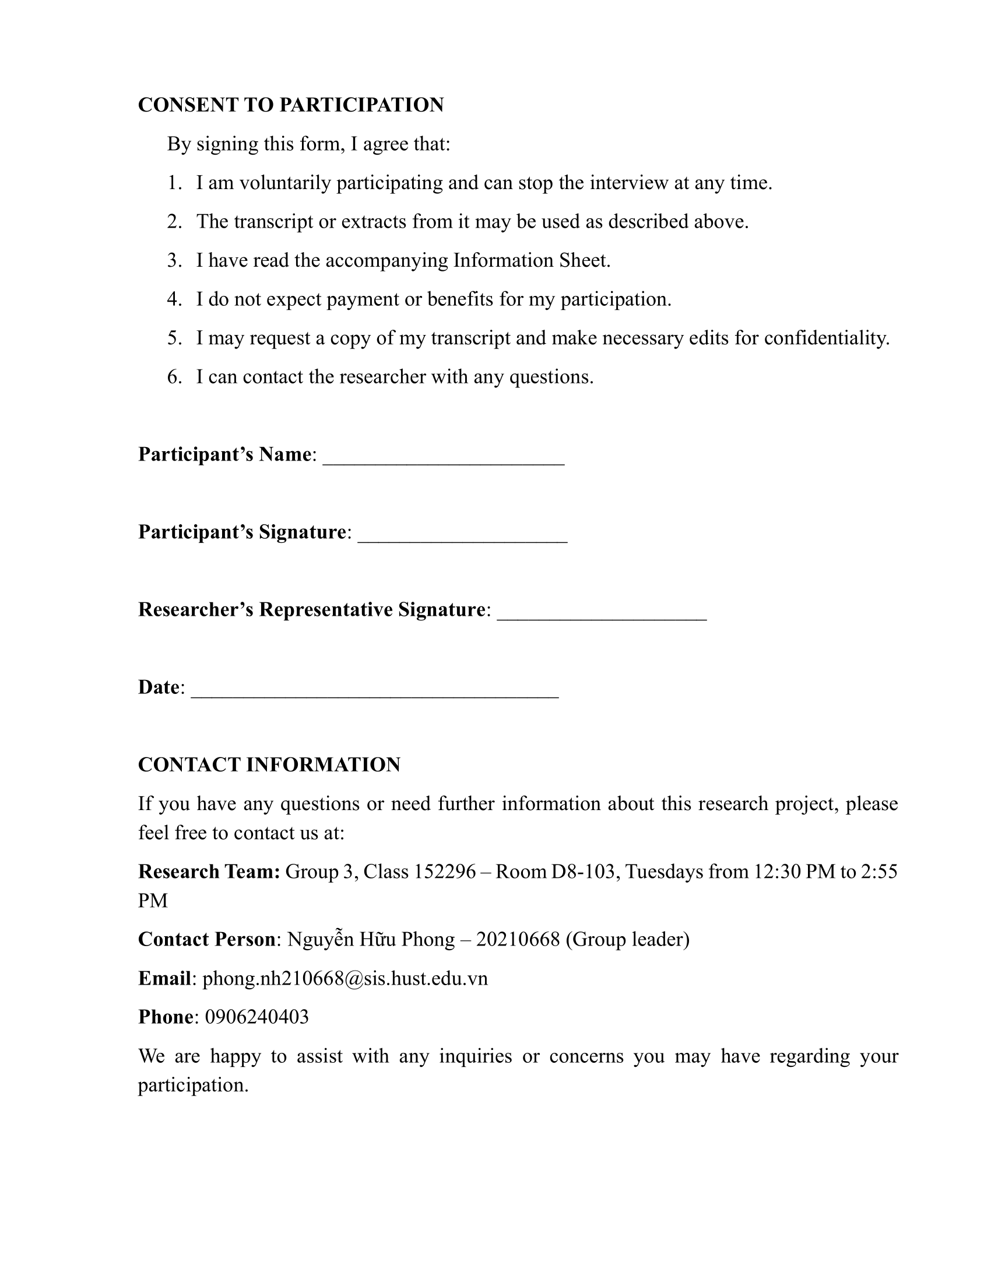
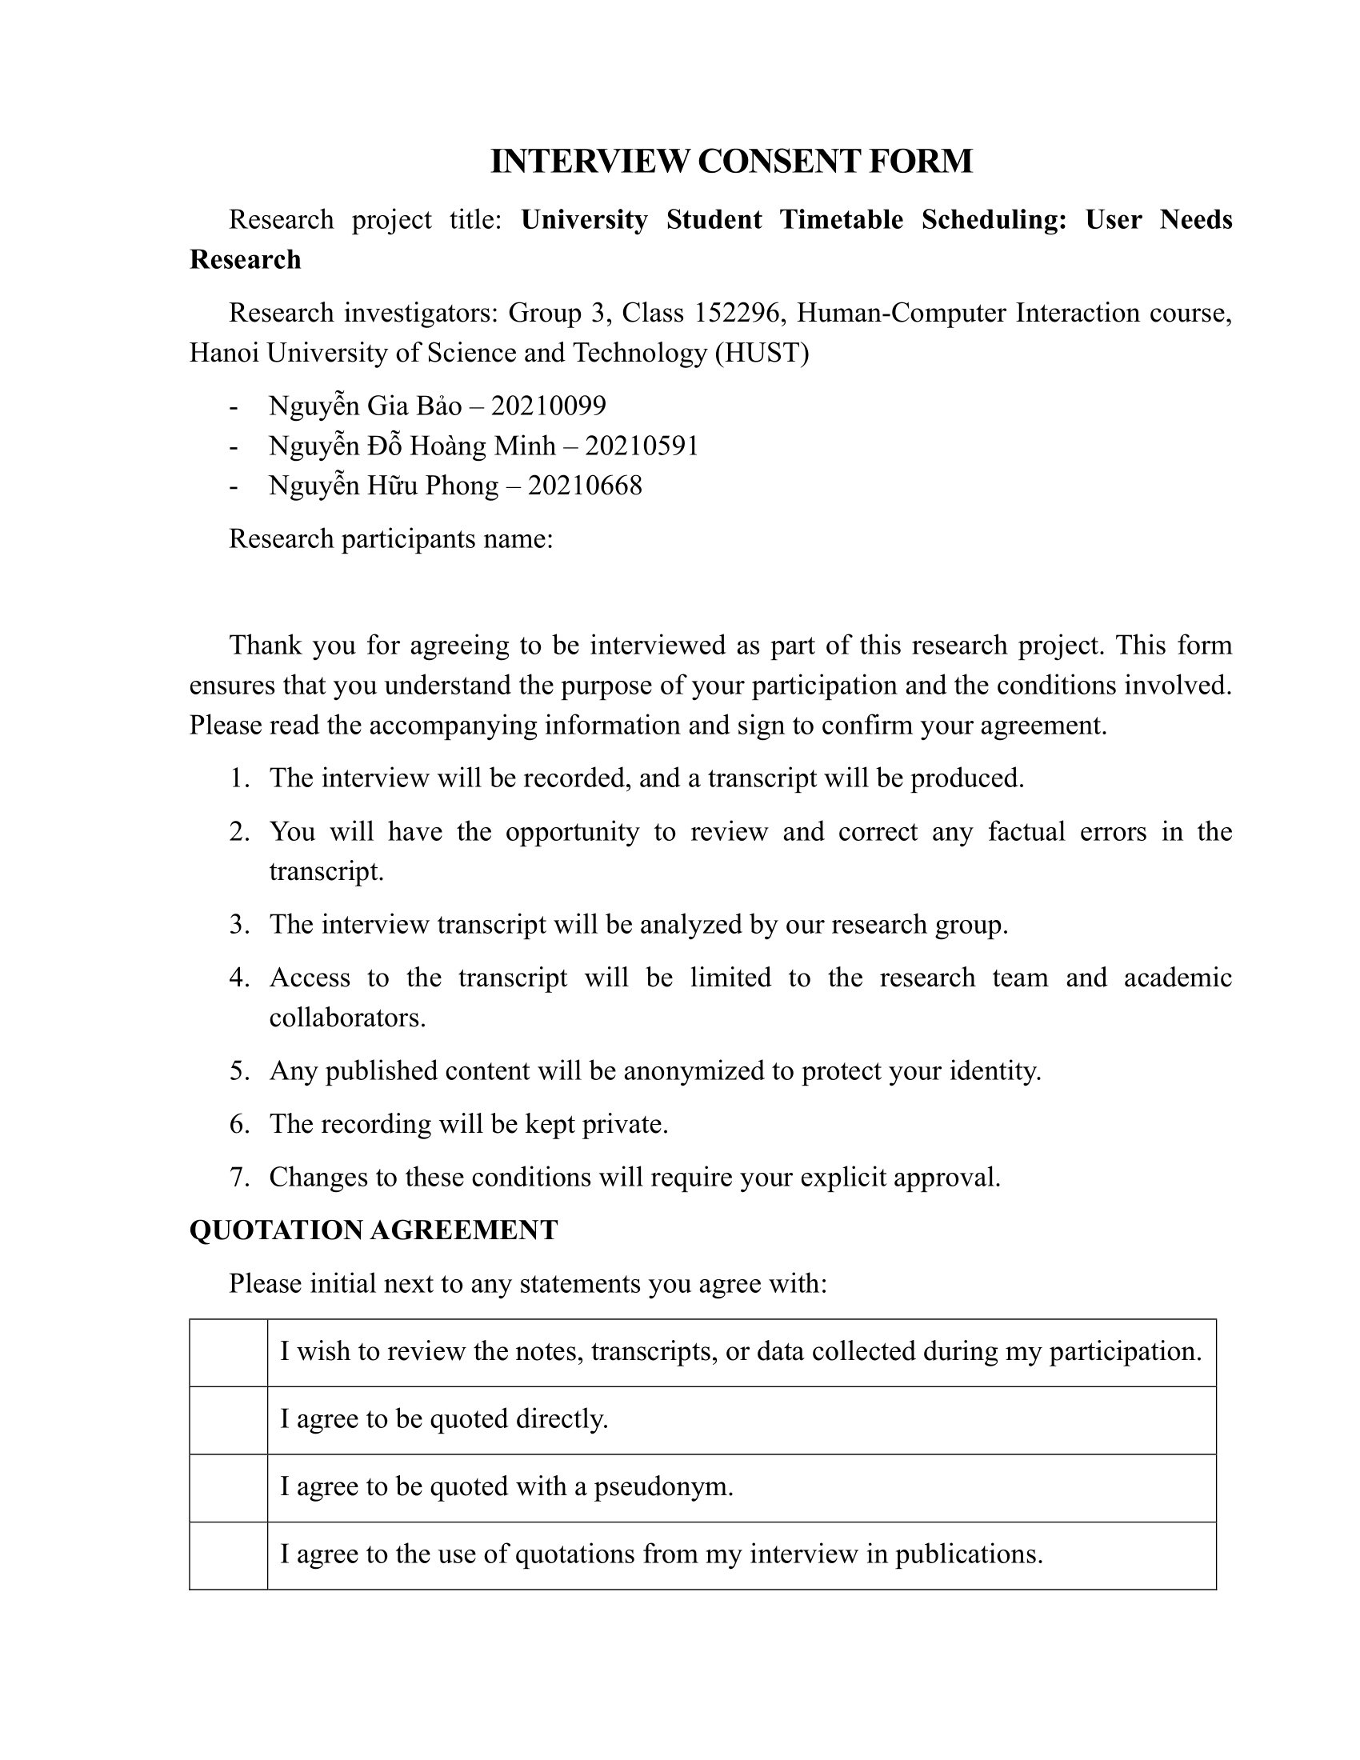
05
Summary
Bonus:
Consent Form

Slide 35

Bonus:
Consent Form
Gì gì đấy có vẻ nhiều thứ lắm hiện tại chưa nhớ ra
05
Summary

Slide 36
TIMETABLE PLANNER WEBSITE
Thanks
Listening!
AC4150E
-
152296
For
User Need Finding
From:
Group 3

